Slide 1
CHAPTER 10 Graphs
Notes:
k33k5是什么东西（弄清楚
图的同构（比较麻烦）判断图不同构（可能考不同构
连通性知道定义（有向图无向图）
联通块
两个图（欧拉图，喊图）
最短路径（考就送分，要看）
（平面图，欧拉公式，判定）
图的着色问题

Slide 2
10.1 Graphs and Graph Models
10.1 Graphs and Graph Models
【Definition 1】 Agraph G=(V,E)
V, set of vertices (or nodes) E, a set of edges
Notation: deg(v)
If deg(v) = 0, v is called isolated.
If deg(v) = 1, v is called pendant.
Let (u, v) be an edge in G. Then u is an initial vertex and is adjacent to v and v is a terminal vertex and is adjacent from u.
The in degree of a vertex v, denoted deg⁻(v) is the number of edges which terminate at v.
Similarly, the out degree of v, denoted deg⁺(v), is the number of edges which initiate at v.

Slide 3
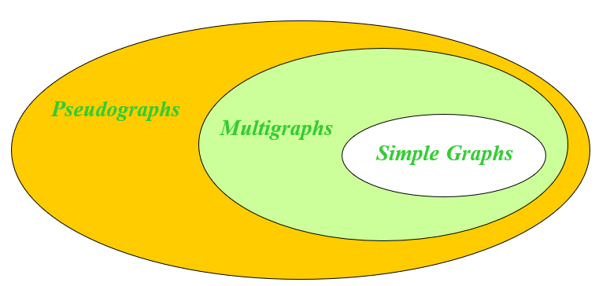
10.1 Graphs and Graph Models
Simple graph: 无环无多重边
Multigraph: 可能有多重边但无环
Pseudograph: 可能有多重边和环
无向图中
For example,
b
b
b
b
c
c
c
c
a
a
a
a
d
d
d
d

Slide 4
10.1 Graphs and Graph Models
【Definition 2】A directed graph (or digraph) (V, E)有向图 consists of a nonempty set of vertices V and a set of directed edges (or arcs) 弧
Simple directed graph: 无环无多重边（指同向）
directed multigraph: 两点间多条有向路
c
c
b
d
b
d
a
a

Slide 5
10.2 Graph Terminology and Special Types of Graphs
Regular graph
A simply graph 条件下
A regular graph is called n-regular if every vertex in this graph has degree n. 规则图（度数相同）

Slide 6
2 Graph Terminology and Special Types of Graphs

Slide 7
10.2 Graph Terminology and Special Types of Graphs
【 Theorem 1】 The Handshaking Theorem 适合所有情况的图
Let G = (V, E) be an undirected graph with e edges. Then
Proof:
Each edge contributes twice to the degree count of all vertices.
推论：奇数度只能偶数个
An undirected graph has an even number of vertices of odd degree.

Slide 8
10.2 Graph Terminology and Special Types of Graphs
【 Theorem 3】 Let G = (V, E) be a graph with direct edges.
Then

Slide 9
10.2 Graph Terminology and Special Types of Graphs
2. Some Special Simple Graphs
(1) Complete Graphs完全图 - K_{n}: the simple graph with
- n vertices
- exactly one edge between every pair of distinct vertices.
The graphs K_{n} for n=1,2,3,4,5.
K₁
K₂
K₃
K₄
K₅
Qusetion:
The number of edges in K_{n} ?

Slide 10
10.2 Graph Terminology and Special Types of Graphs
(2) Cycles C_{n} (n>2) 圈图
C₃
C₄
C₅
C₆

Slide 11
10.2 Graph Terminology and Special Types of Graphs
(3) Wheels W_{n} (n>2) 轮图
Add one additional vertex to the cycle C_{n} and add an edge from each vertex in C_{n} to the new vertex to produce W_{n}.
W₃
W₄
W₅
W₆

Slide 12
10.2 Graph Terminology and Special Types of Graphs
(4) n-Cubes Q_{n} (n>0) n立方图
Q_{n} is the graph with 2^{n} vertices representing bit strings of length n. An edge exists between two vertices that differ in exactly one bit position.
110
111
10
11
100
101
010
011
0
1
00
01
000
001
Q₁
Q₂
Q₃

Slide 13
10.2 Graph Terminology and Special Types of Graphs
3. Bipartite Graphs 二部图
〖Example 2〗 Is C₆ bipartite?
v₁
v₆
v₂
v₅
v₃
v₄
Yes. Because we can display C₆ like this:
v₁
v₆
v₅
v₂
v₃
v₄

Slide 14
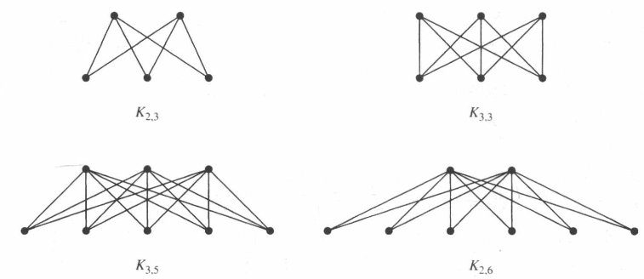
10.2 Graph Terminology and Special Types of Graphs
The complete bipartite graph K_{m,n} 一个集合中的点和对边节点都有边相连
K_{1,n}

Slide 15
10.2 Graph Terminology and Special Types of Graphs
5. New Graphs from Old
边和节点少了都算是子图，a proper subgraph真子图
H is a spanning subgraph of G if

Slide 16
10.2 Graph Terminology and Special Types of Graphs
〖Example 4〗 How many subgraphs with at least one vertex does W₃ have?
Solution:
只取1，2，3，4个点（4个点之间最多有6条边，每条可以选择连或者不连通3+2+1）

Slide 17
10.2 Graph Terminology and Special Types of Graphs
The union of G₁and G₂
The union of two simple graphs G₁ = ( V₁ , E₁ ) and G₂ = ( V₂ , E₂ ) is the simple graph with vertex set V = V₁ ∪ V₂ and edge set E = E₁ ∪ E₂ .
Notation: G₁ ∪ G₂
For example,
e
e
a
d
a
d
a
d
b
c
b
c
b
c
G₁
G₂
G₁ ∪ G₂ = K₅

Slide 18
10.3 Representing Graphs and Graph Isomorphism

Slide 19
10.3 Representing Graphs and Graph Isomorphism
〖Example 3〗 What is the adjacency matrix A_{G} for the following graph G based on the order of vertices a, b, c, d ?
a
b
d
c
Solution:

Slide 20
10.3 Representing Graphs and Graph Isomorphism
3. Incidence matrices 关联矩阵
Let G = (V, E) be an undirected graph. Suppose that
are the vertices and are the edges of G. Then the incidence matrix with respect to this ordering of V and E is n×m matrix , where

Slide 21
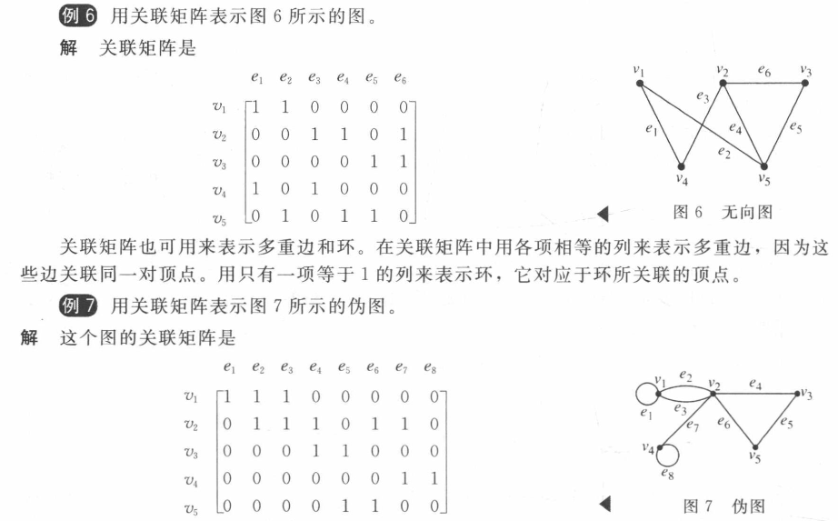
9.3 Representing Graphs and Graph Isomorphism

Slide 22
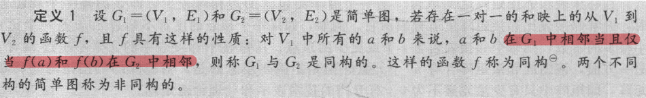
10.3 Representing Graphs and Graph Isomorphism
4. Isomorphism of Graphs 同构
可以用邻接矩阵相同来说明

Slide 23
10.4 Connectivity 连通性

Slide 24
10.4 Connectivity
1. Paths
A path of length n in a simple graph is a sequence of vertices v₀, v₁, . . . , v_{n} such that {v₀, v₁} , {v₁, v₂} , ..., {v _{n-1}, v_{n}} are n edges in the graph.
The path is a circuit if it begins and ends at the same vertex (length greater than 0).
A path is simple if 沿途的每个点都只出现一次
【 Theorem 2】
v_{i} 到 v_{j} 的长度为r的路径为A^{r}中的（i,j)处的值
证明用数学归纳法

Slide 25
10.4 Connectivity
去掉就会让原本联通的图不连通 a cut edge割点 or bridge.
删除一个集合的元素就让图不连通，割集的最小顶点数为
即，最少去掉多少点，就能让G不连通，比如
越大，说明连通性越好
也被称为点联通度
则称为k联通， 同意可以定义边连通

Slide 26
10.4 Connectivity
A directed graph is strongly connected if there is a path from a to b and from b to a for all vertices a and b in the graph.
The graph is weakly connected if the underlying undirected graph is connected.（强连通也属于弱联通）
a
a
b
b
d
d
c
c
Weakly connected
Strongly connected

Slide 27
5 Euler and Hamilton Paths

Slide 28
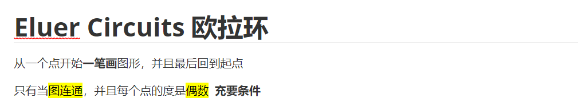
10.5.1 Euler Paths
2. Necessary and sufficient conditions for Euler circuit and paths
有欧拉环的图称为Euler Graph
寻找的办法：除非万不得已，不然不走割边（如果有不止一条的非割边，随便走一条）

Slide 29
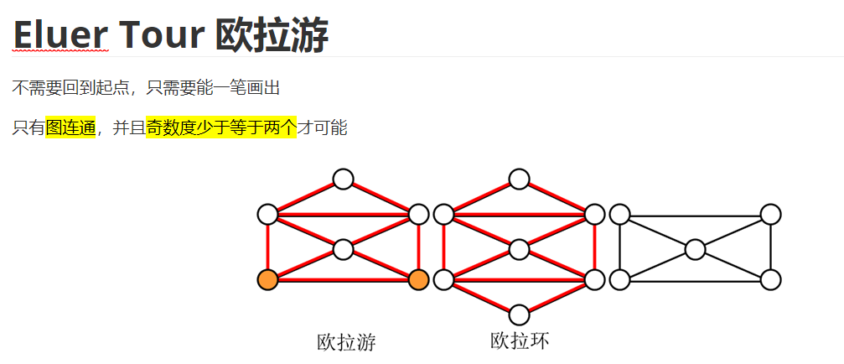
10.5.1 Euler Paths
Path
（又奇数度是偶数个，所以有2个）

Slide 30
10.5.1 Euler Paths
〖Example 2〗 Determine whether the following graph has an Euler path. Construct such a path if it exists.
B
The Euler path:
A,C,E,F,G,I,J,E,A,B,C,D,E,G, H,I,G,J
C
A
J
D
E
I
F
G
H
Solution:
The graph has 2 vertices of odd degree, and all of other vertices have even degree . Therefore, this graph has an Euler path.

Slide 31
10.5.1 Euler Paths
3. Euler circuit and paths in directed graphs
一个没有孤立顶点的有向多图有一个欧拉环，当且仅当
--该图是弱连接的
-- 每个顶点的in-degree和out-degree都相等
一个没有孤立顶点的有向多图有一个欧拉路径，但没有欧拉回路，只有当且仅当
--该图是弱连接的
-- 每个顶点的in-egree和out-degree相等，只有两个顶点除外，一个顶点的in-egree比out-degree大1，另一个顶点的out-degree比in-degree大1

Slide 32
10.5.1 Euler Paths
〖Example 3〗 Determine whether the directed graph has an Euler circuit. Construct an Euler circuit if it exists.
a
b
c
d
Solution:
 | deg⁻(v) | deg⁺(v)
a | 1 | 2
b | 2 | 2
c | 2 | 2
d | 3 | 2
Hence, the directed graph has an Euler path.

Slide 33
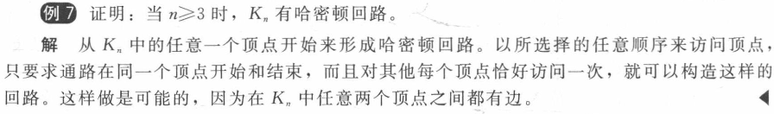
10.5.2 Hamilton paths and circuit
A Hamilton path 经过每个点一次的简单通路
Hamilton circuit
If a connected graph G has a Hamilton circuit, then G is called a Hamilton graph.
边越多越可能有哈密顿环
证明没有哈密顿回路可以用一些显见的结论

Slide 34
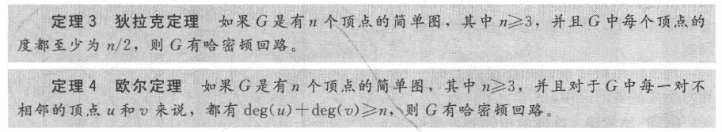
10.5.2 Hamilton paths and circuit
1. The sufficient condition for the existence of Hamilton path and Hamilton circuit
充分但不必要

Slide 35
10.6 Shortest Path Problems

Slide 36
10.6 Shortest Path Problems
Dijkstra’s Algorithm (undirected graph with positive weights）
解决无向正权
【 Theorem 2】 Dijkstra’s algorithm uses O(n² )operations
(additions and comparisons) 发现最短路
Analysis:
使用不超过 n-1 次迭代
Each iteration,
使用不超过 n-1 次比较来确定不在具有最小标签的 Sk 中的顶点S_{k}
不超过 2(n-1) 次操作用于更新不超过 n-1 个标签

Slide 37
10.6 Shortest Path Problems
3. The Traveling Salesman Problem
The traveling salesman problem
The traveling salesman problem asks for the circuit of minimum total weight in a weighted, complete, undirected graph that visits each vertex exactly once and returns to its starting point.
The equivalent problem:
Find a Hamilton circuit with minimum total weight in the complete graph.

Slide 38
10.6 Shortest Path Problems
Solution of the traveling salesman problem
(1) A straightforward method
直接的方法就是检查所有的哈密顿环
The number of Hamilton circuits:
Since a Hamilton circuits can be traveled in reverse order, we need only examine circuits to find the answer.
如果采用近似算法:

Slide 39
Planar Graphs
平面图

Slide 40
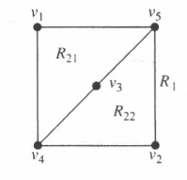
10.7 Planar Graphs
【Definition】没有边交叉的图称为 planar
〖Example 1〗K3，3不可能是planar，最后一个顶点不管怎么放都不行

Slide 41
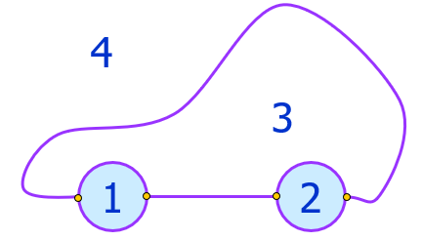
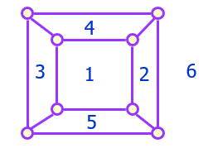
10.7 Planar Graphs
Bounded region有界区域
Unbounded region 无界区域
Note: 平面图上有一块无界区域

Slide 42
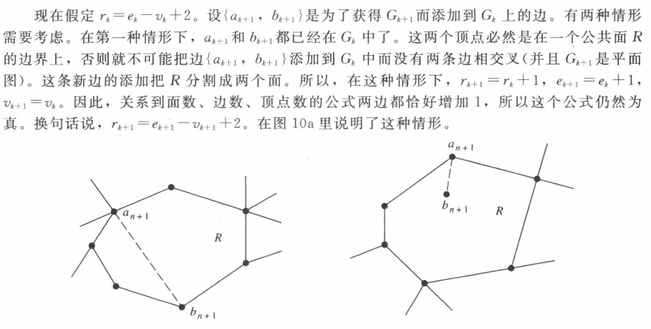
10.7 Planar Graphs
【 Theorem 1】 Euler’s formula
e edges and v vertices. Let r be the number of regions
r=e-v+2.
证明采用数学归纳法

Slide 43
10.7 Planar Graphs
【Definition】 R is a region。 R的度为R的边界上上有多少条边 Notation: Deg(R)
For example,
R₁
R₂
Deg(R₁) = 12 内部的边要算两次
Deg(R₂) = 4

Slide 44
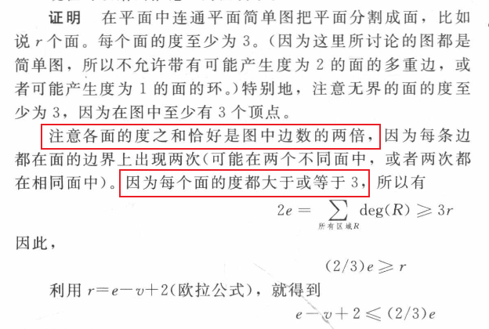
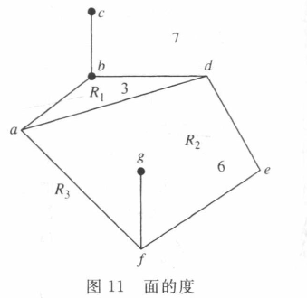
10.7 Planar Graphs
【 Corollary 1 v≥3的平面图（不管连不连通）一定有 e≤3v-6
可以用这条性质来证明某个图不是平面图
Notes:
连通平面图的意思就是，没有交叉边的连通图

Slide 45
10.7 Planar Graphs
【 Corollary 2 】 If G is a connected planar simple graph, then
G has a vertex of degree not exceeding five.
Proof:
e≤3v-6 , so 2e≤6v-12
If the degree of every vertex were at least six, then
2e≥6v

Slide 46
10.7 Planar Graphs
【 Corollary 3 】 If a connected planar simple graph has e edges
and v vertices with v≥3 and no circuits of length 3,then e ≤2v-4.
Generally, if every region of a connected planar simple graph has at least k edges, then
可以用这条性质来证明某个图不是平面图

Slide 47
10.7 Planar Graphs
2. KURATOWSKI’S THEOREM库拉图斯基定理
Elementary subdivision
Homeomorphic
-- 同胚的homeomorphic，如果它们可以通过一连串的基本细分从同一个图形中得到

Slide 48
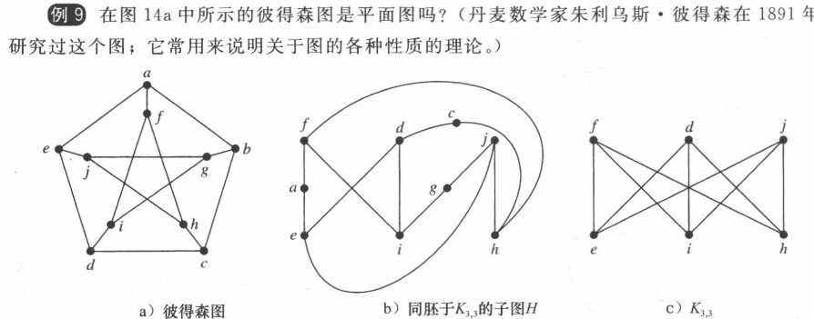
10.7 Planar Graphs
【 Theorem 2】一个图是非平面图当且仅当它包含一个同胚
于K_{3,3} or K₅的子图(包含一个由这两个图细分得到的图)

Slide 49
10.7 Planar Graphs
〖Example 6〗 和上一页同构
a
a
(3)
f
f
e
b
e
b
j
g
j
g
i
h
i
h
d
c
a
d
c
f
e
b
i
h

Slide 50
10.8 Graph Coloring
染色

Slide 51
10.8 Graph Coloring
dual graph 对偶图
给地图着色，等价于对他得对偶图得顶点着色
着色数
A
C
A
C
B
D
F
D
B
F
E
E
四色定理：平面图不超过4色
n为偶，n>=4
n为奇，n>=3
求色数：跳格分类

